Slide 1
Quality by design: ideas for engineering a great presentation
ISPE Continuing Education

Slide 2
AT THE END OF YOUR Session And a month later:
What do you want attendees to
know?
feel?
be able to do?
remember?

Slide 3
There are always three speeches
for every one you actually gave.
The one you practiced,
the one you gave,
and the one you wish you gave.
Dale Carnegie

Slide 4
Thank You for Presenting…
Sharing your experience and expertise
Fostering new insights
Facilitating networking and knowledge sharing
Providing valuable takeaways
Creating an interactive, memorable experience

Slide 5
Quality by Design Resources for You
    Contents
    Quotes
    Content Criteria
    Adults Like It When…
    PowerPoint with a Point
    Brain-Based Learning
    Interaction Ideas
    More Tips for Engineering a Great Session
    What Does Success Look and Feel Like?
    Selected Resources

Slide 6
Design – and Prepare
Outline your presentation
Practice ahead of time
Read and revise
Keep your audience in mind
Take cues from professional speakers
Arrive early
Breathe
“It usually takes more than three weeks to prepare a good impromptu speech.”
Mark Twain

Slide 7
Good to Great
Think about the most impactful, memorable education sessions you have experienced…
What made them not just good, but great?

Slide 8

Content Criteria
Great content is
    Technically accurate, reflecting current industry standards
    Original work (or, when not, attributed properly)
    Clear, with company or specialty acronyms spelled out
    Referenced appropriately using industry format/norms

Slide 9

Content Criteria
Great content is
    Verified and made stronger through feedback from peers
    Content-focused and commercial free
    Deliverable within the allotted time
    Embedded with interaction opportunities
    Coherent - aligned for the topic, purpose, and audience

Slide 10
Adults (tend to) Like It When You
Recognize and tap their prior knowledge
Value their time
Prioritize and order your content thoughtfully
Are clear and interesting
Engage their imagination, senses, logical reasoning, and creativity
Remember…
The one who does the work does the learning.

Slide 11

Adults (tend to) Like It When You
Let them know where you are going and why
Talk and lead, but also listen and notice
Facilitate problem solving on critical issues
Create networking and interaction opportunities

Slide 12

Adults (tend to) Like It When You
Provide them with tangible, practical takeaways
Bring your material/ideas/concepts to life using effective
    Data points
    Examples
    Stories
    Models
    Metaphors
    Visuals
    Case studies
    Frameworks that make sense of complexity/change
From chaos, patterns emerge.

Slide 13

Adults (tend to) Like It When You
Empower them to see/learn/think/feel differently
Provide access to resources, strategies, tools
Make meaningful connections
Cultivate commitment
Ask compelling, memorable questions
What will success look like
five years from now?

Slide 14

Adults (tend to) Like It When You
Inspire. Leave your audience determined to
    Learn/do/get involved more
    Incorporate their learning into their work
    Impact others positively, in their company, networks, and field
    Share it with others
    Make a better world.

Slide 15
Collaborate and Coordinate
Plan your presentation in coordination with your Session Leader and the other speakers
    Get together by email and on the phone
    Compare notes on content, priorities, and flow
    Prepare for and anticipate questions
    Plan diverse interaction activities & discussion time
    Luck is the residue of design.

Slide 16

Be a Good Colleague
    Be clear on the exact time for each person and segment
    Use a stop watch to time your talk
    Practice the art of summarizing
    Prioritize your time and content
    End on time

Slide 17
PowerPoint with a
Speakers use PowerPoint for many (sometimes conflicting) purposes:
Detailed reference notes
A handout for participants
A historical record of where/when/what
Descriptions of stuff for everyone to read
A cue card for what to say next
A visual cue for the audience
Is there a better way?

Slide 18
PowerPoint with a
Think. Plan. Break it down. Experiment…
Give attendees a handout
Put your reference details on a cheat sheet
Reorganize your talk so it flows better
Prioritize & add punch – make it memorable
Practice & internalize so you speak naturally
Use simple visuals/key words as your cues
Step away from PPT to tell a story
Find out what works best for you/your audience.

Slide 19
PowerPoint with a
And above all try to avoid putting tons of small print on each slide with overly wide margins all done in complete sentences and small font size with a multitude of font types and tiny numbers on the screen that the audience can’t possible absorb, especially those sitting in the back who just flew in from overseas and are highly jetlagged and new to your particular sub-discipline, when in fact brain science is very clear on the fact that
We are all visual learners
We can really only focus on one thing at a time
Too much stimulation, movement, and color all at once can be highly distracting

Slide 20
PowerPoint with a
For more, check out this TEDx TALK by
David JP Phillips (2014, 20 minutes)
Five presentation design principles based on neuroscience
Why it’s a mistake to put too many items on a PowerPoint slide
How to Avoid Death by PowerPoint

Slide 21
PowerPoint with a
The Secret Structure of Great Talks:
Nancy Duarte is a speaker and presentation design expert. In her TED Talk, she dissects the 4 elements of a great presentation:
What is
What could be
A moment to remember
Promise of “New Bliss”
The Secret Structure of Great Talks

Slide 22

  Remember…
  Metaphors
  and images
  can be
  powerful

Slide 23

  Help make sense of complexity with systems thinking, frameworks, examples, and mental models

Slide 24

  Are there people in your story?
  There always are, and they tend to be important to the story, concerning innovation, human factors, quality culture, organizational learning, hiring decisions, investment priorities, mergers, planning, patient outcomes…Are there stories in your presentation?

Slide 25
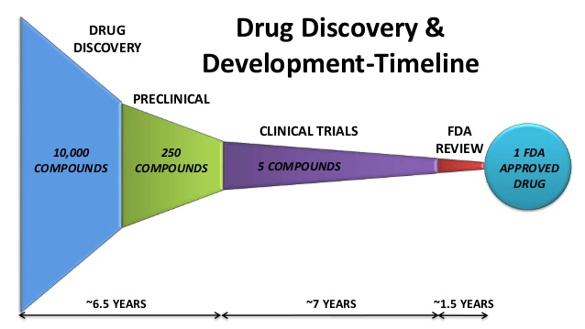
Simple graphics work well in PowerPoint to tell a story

Slide 26
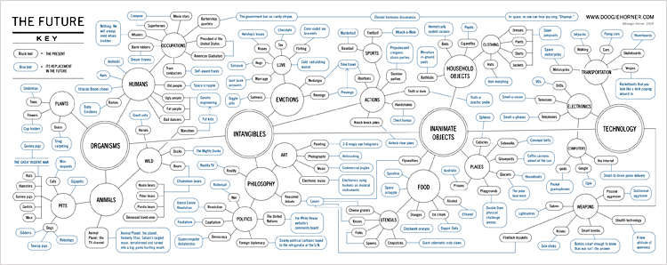
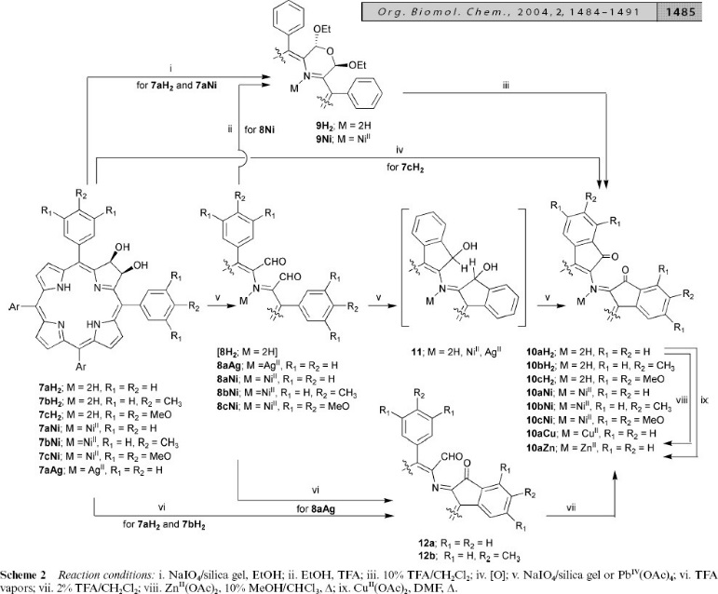
Small-print flow charts, equations, or numbers on the screen are only useful for conveying a general image of complexity. To have a useful take away, attendees will need a handout.

Slide 27
Brain-Based Learning: Key Nuggets
Help your audience focus
      We are all visual learners
      Minimize distraction. Multi-tasking is a myth.
      Map/match your methods to your goals, objectives, & outcomes
Light travels faster than sound.
---------------------
That is why some people appear bright until they speak.
What do you want your audience to feel/know/be able to do/remember? Today? Next month? Next Year?

Slide 28

Brain-Based Learning: Key Nuggets
Be mindful of your energy & the energy in the room
    Every ten minutes or so our brains start to go to sleep
    Change up the energy with engagement, movement, or interaction
    Balance intense focus/activities/information with pauses for reflection
Energy Comes in Waves

Slide 29

Interaction Ideas
    Share with us your tips! What works for you?
    Quick and simple
      Show of hands quick poll: How many people…?
      Ask a compelling question, give a moment for reflection, get examples from the group
      Write/reflect on a challenge for two minutes, then share

Slide 30

Interaction Ideas
    Pairs and groups
      Turn to your neighbor
      Brainstorm at your table
    Get up, get moving
      Stand up, talk to two people you don’t know
      Quick survey – then stand up, find a new table based on common challenges/roles/company type
      Regroup and share ideas on flipcharts

Slide 31
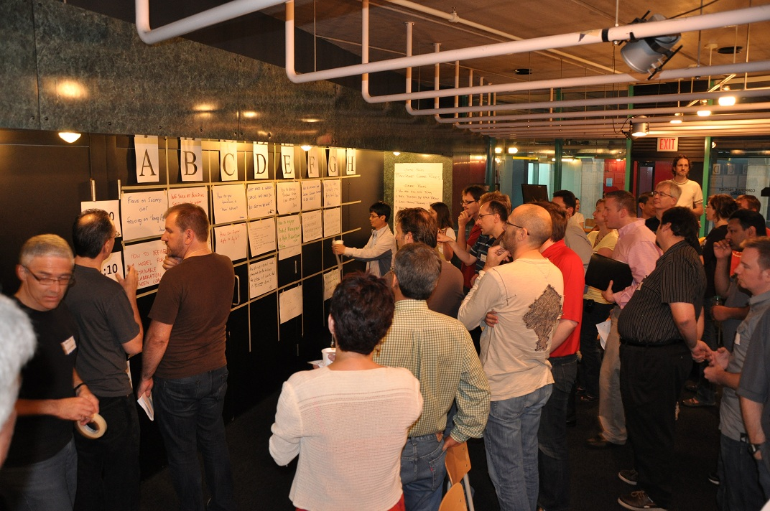
There Are Hundreds of Interaction Ideas
    Right brain: group doodle/draw a factory of the future
    Do a mini open space - crowd source ideas/questions

Slide 32

Tips for Engineering a Great Session
Start early: plan, prepare, step away, come back later to revise it when you are fresh
A key to having creative breakthroughs,
inventing, problem-solving, innovating, and
designing, is stepping away from the problem.
Your mind will still be working on it while you are sleeping, relaxing, or walking!

Slide 33

Tips for Engineering a Great Session
Design slides people can “get” in three seconds
Consider not using slides: try Prezi, or no slides
Break your talk into 10-minute modules
Use a TED talk-type format
Don’t try to cover too much.
Less (just right) is best.

Slide 34

Tips for Engineering a Great Session
Storyboard your presentation first
Build your talk with a memorable structure around
    Case studies
    Critical quality attributes in a mnemonic or acronym
    An engaging story
    Key questions driving innovation

Slide 35
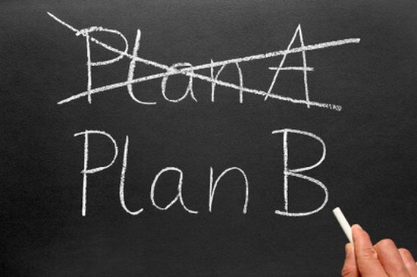
Tips for Engineering a Great Session
Learn as much as you can about your audience
Use technology intentionally, with learning in mind
Test your equipment and have a backup plan
Bring your talk on a USB and have a hard copy
Troubleshoot and anticipate
Refer to your slides - avoid reading

Slide 36
Tips for Engineering a Great Session
Warm up your voice. It is a beautiful instrument
Know your key points of emphasis/outcomes/priorities
Know where there will be emotional moments & stories
Plan pointed pauses
Get off to a good start, hold the middle, finish strong
Music would not be music without rhythm and rests.

Slide 37
What Does Success Look/Feel Like?
Peak performances, whether in sports, public speaking, or any endeavor, are all about flow—that great feeling of relaxed concentration when preparation and performance come together.

Slide 38

What Does Success Look/Feel Like?
There is no such thing as a perfect presentation given the complexity and diversity of contexts, contents, constraints, personalities, challenges, opportunities, experiences, expertise levels, needs, goals, perspectives, and organizations that make up a typical conference session/audience.
There are many pathways to success.

Slide 39

What Does Success Look/Feel Like?
Practice
Adjust
Relax
Breathe
Focus
Flow
Think
Envision
Research
Reflect
Design
Plan
Storyboard
Prepare
Rethink
Revise

Slide 40
Selected Resources
Why Most PowerPoint Presentations Suck and How You Can Make Them Better (Rick Altman)
Brain Rules (John Medina)
Make It Stick: The Science of Successful Learning (Peter Brown, Henry Roediger III, Mark McDaniel)
Evidence-Based Training Methods (Ruth Colvin Clark)
Thinking in Systems (Donella Meadows)
The Doodle Revolution: Unlock the Power to Think Differently (Sunni Brown)
Flow: The Psychology of Optimal Experience (Mihaly Csikszentmihalyi)
The Power of Full Engagement (James Loehr, Tony Schwartz)

Slide 41

Thank You for…
Engaging peers with questions that advance the field
Demonstrating your commitment through ISPE to
    Continuous learning
    Lifelong professional development

